Slide 1

Benefits Brief
Notes:
U.S. Navy Reserve Benefits Brief is designed to inform transitioning service members or those nearing separation about opportunities and benefits in the Navy Reserve (SELRES).

Slide 2

“CNO has set the course: Sailors first, relentless readiness, rapid modernization, and combat credibility.”
Rear Admiral Richard S. Lofgren
Acting Chief of Navy Reserve
Acting Commander, Navy Reserve Force

Slide 3
Enabling Objectives
Discuss the following:
Benefits of Reserve Affiliation
Opportunities and Selected Reserve (SELRES) Requirements
Applying for SELRES Billets and Navy Reserve Center Locations
Different Types of Orders and ZipServe
How to Affiliate into SELRES
Military Service Obligation (MSO)
Notes:
Introduce the session’s purpose and what attendees will learn.

Slide 4

Benefits of the Navy Reserve
Warfighter. Remain fully trained and deployable, directly contributing to mission success and national defense.
Sailor for Life. Proudly wear the uniform and maintain Navy identity, even while balancing careers, education, and family life.
Community. SELRES maintain strong bonds with their units, fellow Sailors, and local communities.
Notes:
Talk about how SELRES Sailors continue to serve in meaningful ways while maintaining civilian careers. Emphasize pride, purpose, and continued impact.
Key Points:
Warfighter: Stay trained and ready
Sailor for Life: Keep Navy identity
Community: Maintain strong personal and professional connections

Slide 5
Benefits of Navy Reserve Earn Pay and Retirement Eligibility
SELRES are paid for four days of Active Duty for two days of work​
SELRES receive ½ month’s pay and BAH for two-week Annual Training (AT)
New SELRES affiliations may qualify for a bonus
Drill Weekend (DWE) Pay
OFFICER (Over 4 Years) | DRILL WEEK PAY | ENLISTED (Over 4 Years) | DRILL WEEK PAY
O-5 | $1,142.48 | E-6 | $522.64
O-4 | $1,012.32 | E-5 | $468.96
O-3 | $948.32 | E-4 | $427.24
Notes:
Reserve duty can be financially rewarding. Describe how pay and bonuses may apply, especially the 4-for-2 drill pay system.
Key Points:
Paid for 4 days for 2 days of drill
Annual Training (AT) = Half month’s base pay + BAH
Potential for Affiliation Bonus
How many years used for reference on this pay chart?

Slide 6
Benefits of the Navy Reserve: Reserve Retirement System
Reserve Retirement Points = Quantitative means of crediting time served by SELRES to correlate to active duty.
Sailors must earn enough Retirement Points in a specific period for at least 20 Qualifying Years to earn Reserve Retirement eligibility.
This specific time period is known as the Anniversary Year (AY).
If you already served on Active Duty or in another Service, you have likely accrued years toward 20 Qualifying Years.
Typical Anniversary Year
Navy Reserve Membership | 15 points
Inactive Duty Training (IDT) periods One DWE per month / Four IDT periods per DWE | 48 points
Annual Training (AT) 12 to 14 days (point per day) Must be conducted each FY and within Sailor’s Anniversary Year | 12 to 14 points
Notes:
Active Points
AC / TAR / AT/ ADT/ ADOS/ MOB / DR / CANREC
One day = one point
Max active points/year: 365/366
Inactive Points
Inactive Duty Training
Funeral Honors
Membership Points: 15 per anniversary year

Slide 7

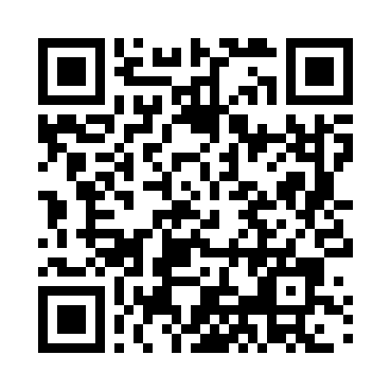
Healthcare Benefits
Transitional Assistance Management Program (TAMP)
The first 180-days of health care coverage may be premium-free under TAMP for those that affiliate immediately
Cost efficient Health Insurance
SELRES eligible for TRICARE Reserve Select (TRS) and TRICARE Dental Program
Premium (Monthly) | TRICARE Reserve Select | TRICARE Dental Program | National Average
Sailor Only | $53.80 | $ 28.82 | $575
Sailor + Family | $274.48 | $ 74.94 | $1,675
Notes:
Healthcare is a major concern for transitioning Sailors. Explain options like TAMP and TRICARE Reserve Select, which are affordable and accessible.
Key Points:
TAMP: 180 days free healthcare post-separation (if affiliated immediately)
TRICARE Reserve Select: Premium-based coverage
TRICARE Dental Program available
References:
1. TRICARE Reserve Select. TRICARE.mil. https://www.tricare.mil/Plans/HealthPlans/TRS
2. Kaiser Family Foundation (KFF) 2024 Employer Health Benefits Survey. https://www.kff.org
3. Healthcare.gov 2024 Marketplace Premiums. https://www.healthcare.gov
4. Military.com TRICARE Overview. https://www.military.com/benefits/tricare
5. U.S. Bureau of Labor Statistics. Consumer Expenditures Report 2024.

Slide 8

Basic SELRES Obligations
Maintain Mobilization Readiness
What does that mean?
Remain current and up-to-date with:
Training Requirements: Rate training
Physical Requirements: PARFQ/PFA
Medical Requirements: PHA, Dental
Administrative Requirements: CMT’s, PG-2, NFAAS
One Drill Weekend (DWE) per month required
One two-week Annual Training (AT) required
Notes:
Clearly define what’s expected of SELRES Sailors monthly and annually. Emphasize readiness and documentation.
Key Points:
1 drill weekend/month
2-week Annual Training
Stay current on: PHA, Dental, PARFQ, PG2, CMTs, etc.
Have 40 of 48 scheduled regular IDT periods favorably adjudicated per FY
Perform a minimum of 14 days AT each FY as scheduled by the Unit CO
Report for physical exams and provide medical information as required
Respond to all official correspondence
Provide current address, home and work phone numbers, and email address
Notify command of changes in physical, dependency, and employment status, or
any other factors that could impact mobilization
Comply with involuntary recall to active duty as required
Have a signed NAVPERS 1570/2, Satisfactory Participation Requirements/Record of
Unexcused Absences in their individual IDT folder in the current records
management system
1 Drill Weekend per month
2-Week Annual Training (AT)

Slide 9


Advancement Eligibility
Recommendation from CO/OIC
Have minimum Time-In-Rate (TIR)/(TIS from E1-E4)
Be in the proper path for advancement
If required, complete service schools
Evaluation completed within cycle
Enlisted Leadership Development (ELD) courses are required prior to taking the exam for E6 and E7 candidates
Professional Military Knowledge Eligibility Exam (PMK-EE) and ELD courses are mandatory for participation in advancement cycles. Complete each once per paygrade (Except E4).
Advancement Exam Cycle
E-7 | February | -
E-6 | February | August
E-5 | February | August
E-4 | February | August
Notes:
Reserve Sailors are still eligible to promote. Walk through requirements and emphasize the importance of PMK-EE and Enlisted Leadership Development courses.
Key Points:
CO recommendation, TIR/TIS eligibility
Service schools & evaluations matter
PMK-EE & Leadership Courses required (E6+ mandatory as of Jan 2025)

Slide 10
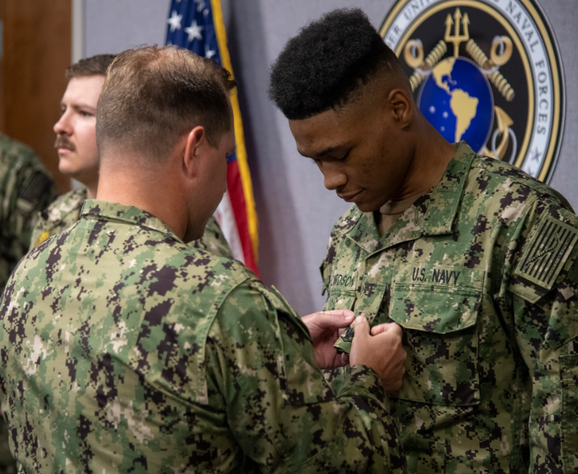
HYT Gates
Selected Reserves HYT limiting gates are different from Active-Duty gates
Provides opportunities to serve longer
RANK | YEARS
E-1/E-2 | 6 Years (no waivers)
E-3 | 10 Years (no waivers)
E-4 | 14 years
E-5 | 20 years
E-6 | 22 years
E-7 | 24 years
E-8 | 26 years
E-9 | 30 years
Notes:
HYT policies in the Reserves differ from active duty. Highlight flexibility and career continuation opportunities.
Key Points:
Different HYT rules from AD
Allows longer service for motivated Reservists

Slide 11
Officer Career Management
Reserve Officer Community Management (BUPERS-351)
26 SELRES officer communities
Recall Opportunities
Active Duty for Operational Support (ADOS)
Definite (Temporary) Recall
Indefinite (Permanent) Recall/Redesignation
Reserve Officer Promotion Boards
Managed by PERS-801
Additional information can be found on the the MyNavyHR homepage

Slide 12






Career Development and Education Opportunities
Career Development Boards
“A” and “C” School Opportunities
SELRES Tuition Assistance
Navy Cool/USMAP
USNCC
MGIB-SR
Transfer Post 9/11
Notes:
SELRES members have full access to career and educational benefits. Stress that affiliation doesn't limit professional growth.
Key Points:
“A” and “C” schools
Tuition Assistance
Navy COOL, USMAP, USNCC
GI Bill (Post-9/11 & MGIB-SR)

Slide 13
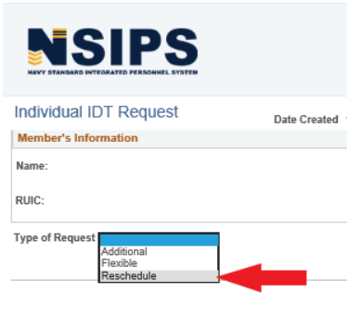
Enhancement for Drill Management (EDM)
Self-service module within NSIPS used for managing drill participation, pay, and retirement points.
One Drill Weekend = Four Drill Periods
Request rescheduling or additional training periods
Authorized Absences (AAs): Excused completely from participating in drill
Notes:
Walk through EDM in NSIPS for managing drills and pay. Help them understand flexibility through reschedules or AAs.
Key Points:
1 drill weekend = 4 periods
Self-manage drills and reschedules
Authorized Absences (AAs) available
Explain administrative and operational commands. Encourage using MNA and RFMT. Mention importance of Reserve Tutorial.
Key Points:
TRUIC = Admin unit
UMUIC = Mobilization unit
MNA: Apply for billets
RFMT: Get orders
Unit Assignment
Training Unit Identification Code (TRUIC): Administrative Command
Unit Mobilization Unit Identification Code (UMUIC): Operational Command
Search and apply for billet within MyNavy Assignment (MNA)
Junior Officer Apply (JO Apply): Apply for a billet within a unit
Reserve Force Management Tool (RFMT): Receive official orders to your unit
Review the “Reserve Tutorial” on the MNA Homepage

Slide 14

Weekend Drill Child Care
Supports Reserve families by providing fee-assisted childcare during weekend drills (IDT).
Key Benefits:
Up to 24 hours of childcare per month for drill
Fee assistance allows for reservist to pay $3/hour per child
Covers children ages 6 weeks to 12 years
Multiple provider types accepted
Enrollment Process:
Visit MilitaryChildCare.com/WDCC
Submit a request through the MCC portal
Upload orders and drill schedule
Select an eligible provider and complete required documents
Notes:
Family concerns are valid—show how the Navy supports families with fee-assisted child care during drills.
Key Points:
MilitaryChildCare.com for enrollment
$3/hr per child
Covers 24 hours/month
Ages 6 weeks to 12 years

Slide 15


Support Resources
Navy Reservists, whether drilling part-time or on active-duty orders—retain access to many of the same support resources as their active-duty counterparts, including Military OneSource, Fleet and Family Support Centers, and crisis hotlines.
You and your family still have full access to essential resources to help navigate military life, whether you are drilling, deployed, or balancing civilian responsibilities in between.
Notes:
Affiliated Reservists retain support equal to active-duty counterparts. List out critical services available.
Key Points:
Military OneSource
Fleet & Family Support Centers
Crisis hotlines
Full access for families and Sailors

Slide 16

Other Benefits
Base Access
Commissary
Lodging
Morale, Welfare, and Recreation (MWR) Programs
Information, Tickets and Travel

Slide 17
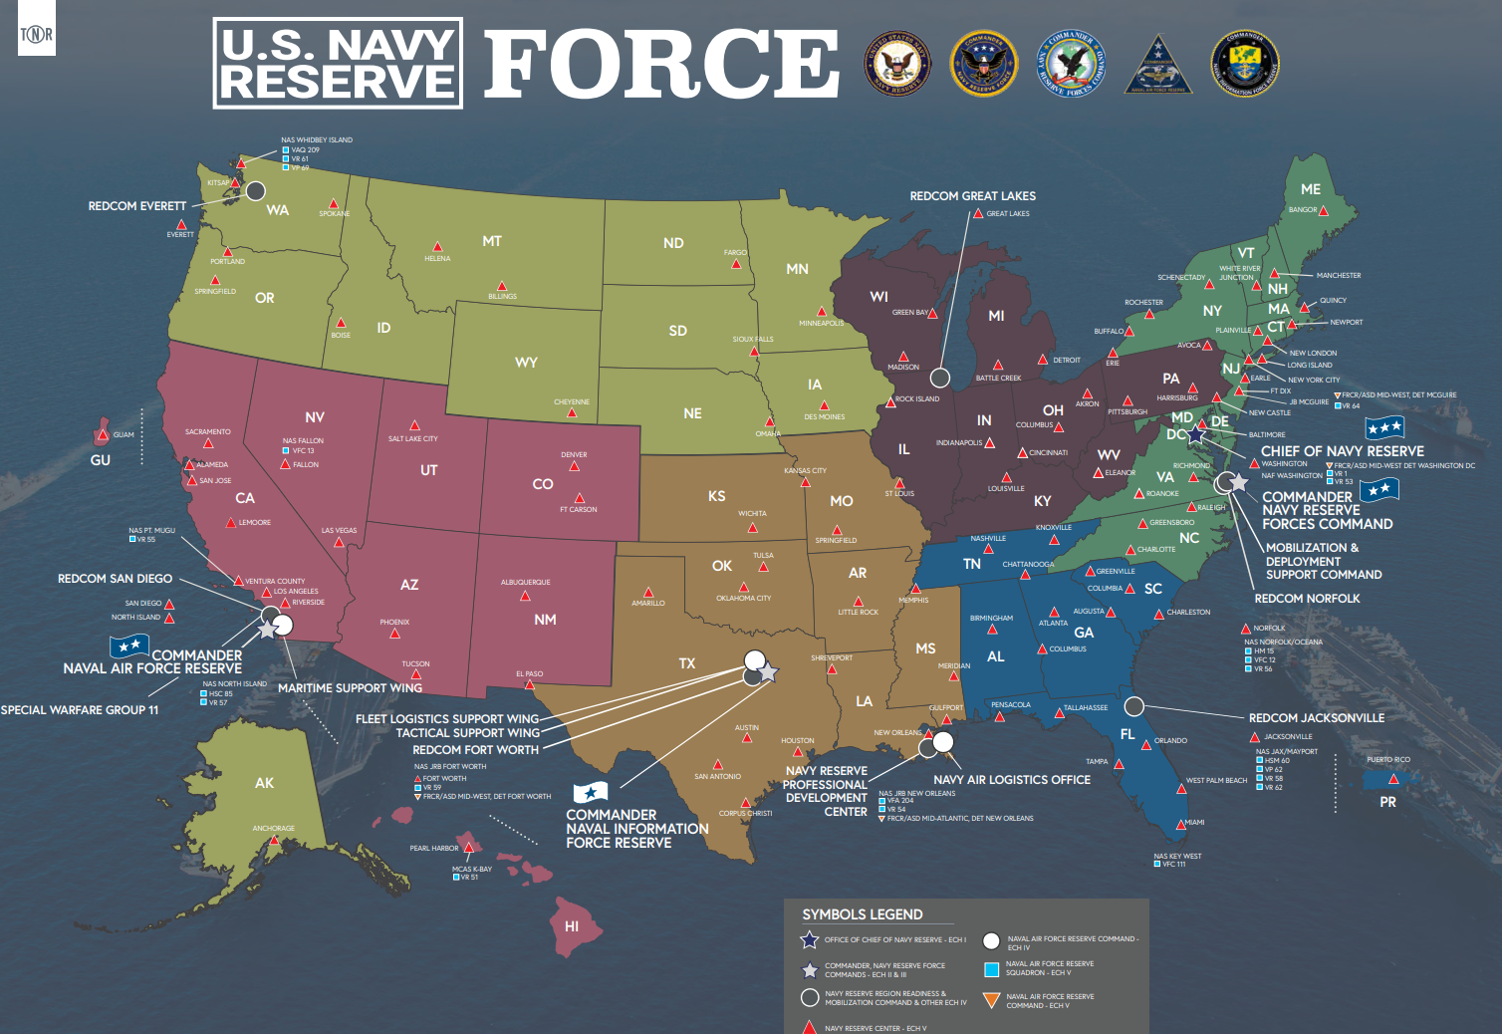

Slide 18
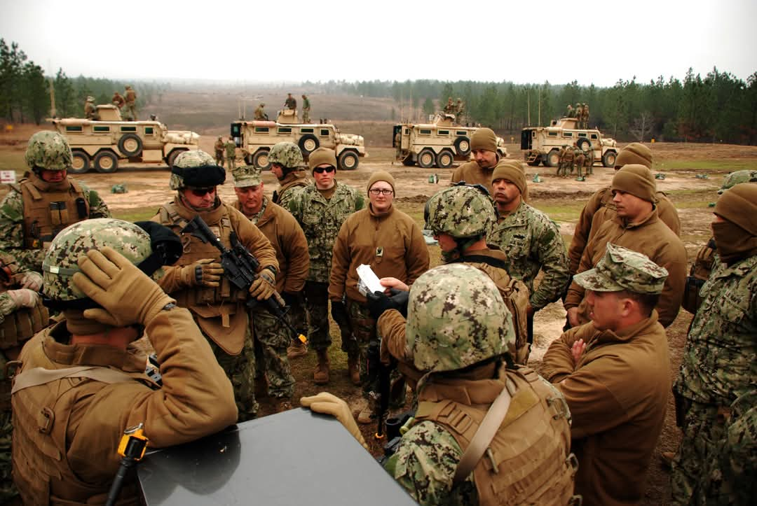
Full- Time Opportunities
Voluntary temporary recalls to active duty (Definite Recall) for durations of 1-3 years are available. While on these orders the Sailor will earn full, Active Duty pay and benefits.​
Voluntary Active Duty for Operational Support (ADOS) and Active Duty for Training (ADT) allows periods of active duty in a variety of capacities​.
Indefinite Recall is a path back to full-time active duty​ service.
The Training and Administration of the Reserve (TAR) program allows Navy Reserve Sailors to serve full-time on active duty, supporting the operational readiness and administration of the Navy Reserve. TAR Sailors ensure Reserve personnel are trained, equipped, and ready to mobilize when needed, receiving the same pay, benefits, and career progression opportunities as active-duty Sailors.
Notes:
Describe ways Reservists can go full-time, short-term or long-term. Focus on the flexibility to support both civilian and Navy careers.
Key Points:
Definite Recalls (1–3 years)
ADOS, ADT opportunities
Indefinite Recall to Active Duty
May request six months AA per RESPERSMAN
TAR Program (full-time support staff)

Slide 19

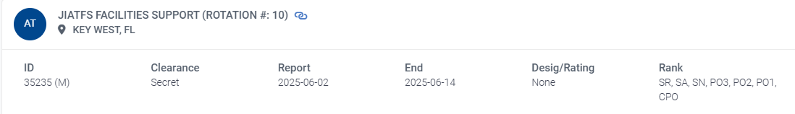

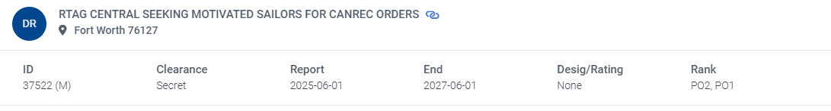
ZipServe
ZipServe offers a one-stop shop for Reserve Sailors to find and apply for various orders.
AT, ADOS, Recall, IDTT, ADT
ZipServe connects qualified, motivated Reservists with short-term or long-term opportunities. Whether you are looking to gain experience, get paid, and contribute to the mission, ZipServe makes it easy to find and apply for orders.
Notes:
ZipServe simplifies order applications. Relate it to Indeed/LinkedIn for jobs. Encourage them to explore.
Key Points:
Apply for AT, ADOS, IDTT, DR
Centralized platform
Easy to filter and apply

Slide 20
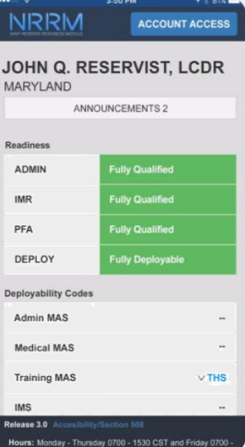

Participation Made Easy
The Navy Reserve provides the ability to use your personal iOS or Android device to access Navy Flank Speed Services.
Access Anywhere: use personal devices to connect.
Secure and Private: Personal and work data remain separate, with app-specific security.

Slide 21
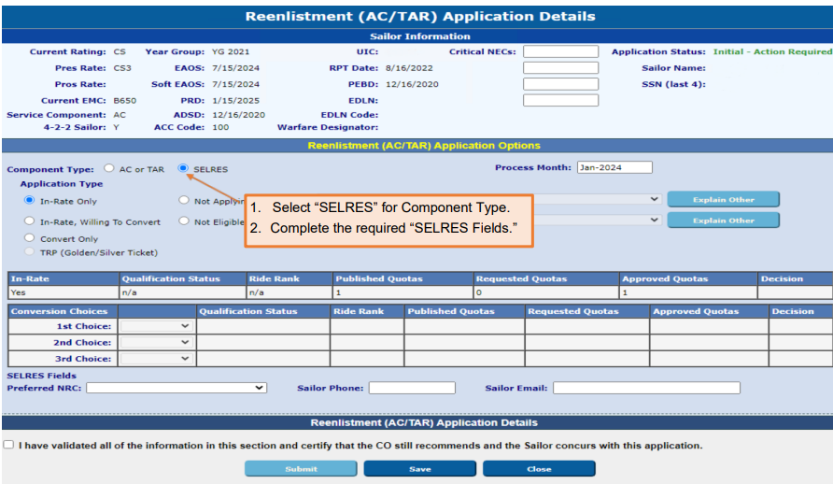
Pathways to Affiliation
Career Waypoints ​
Begin application 10 months from SEAOS​
Direct affiliation​
2-year deployment deferment​
Special Request (ePAR / NAVPERS 1306) ​
Within 90 days of separation​
Outside of CWAY window ​
Direct affiliation ​
Navy Reserve Recruiters
Notes:
Walk through affiliation timelines. Provide clarity on CWAY vs Direct Affiliation vs Special Requests.
Key Points:
CWAY: Start 10 months before SEAOS
Within 90 days = Direct Affiliation
Use ePAR/1306 for special requests
Navy Reserve Recruiters for support

Slide 22
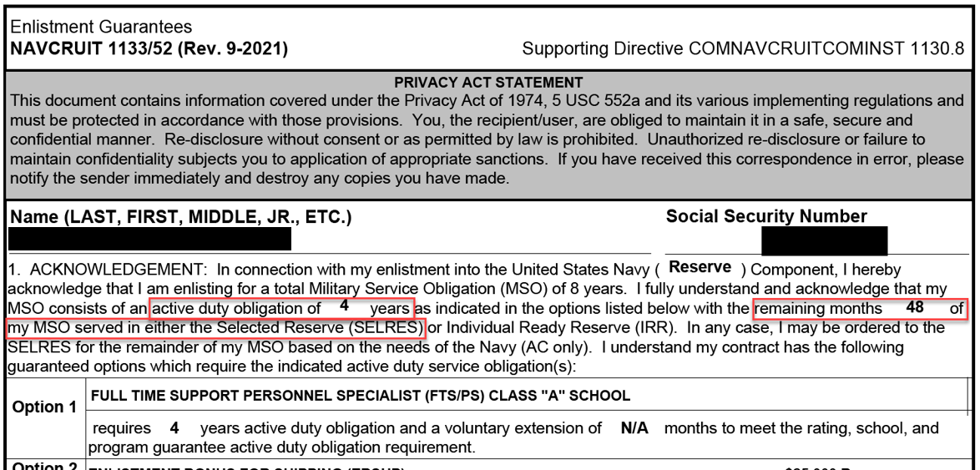
Military Service Obligation Does your contract have a SELRES obligation?
4-2-2 construct
Minimum 4 years of Active-Duty service
2 years in SELRES status
2 years in the IRR (virtual muster)
Block 7a of DD214 is another source for calculating MSO
Notes:
Explain the 4-2-2 construct and how it applies.
Explain the 8-year service obligation. Many Sailors don't realize they’re still obligated after active duty. Clarify the 4-2-2 model and the transition between components.
Key Points:
8-year obligation (MSO)
4 years Active Duty
2 years SELRES
2 years IRR (Virtual Muster)

Slide 23
NRRC E-Talent POCs
NRRC E-Talent:
nrrc_etalent@us.navy.mil
(901) 300-0423
LCDR Victoria Blackley
victoria.e.blackley.mil@us.navy.mil
(901) 874-9091
NCC (SW) Paul A. Burke
paul.a.burke6.mil@us.navy.mil
(901) 874-9250
Please include the following information in an email so that E-Talent can forward your details to the benefits advisor nearest to you:
Name
Address
Phone
Email
Current duty station (if applicable)
Best time/method of contact

Slide 24

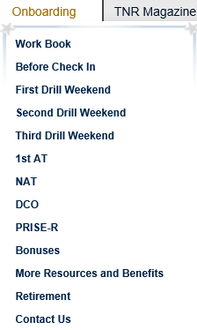
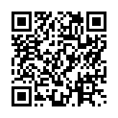
Onboarding Website
Centralized information to help you each step of the way
Use this website as a great starting point
Notes:
Show them where to go for help, onboarding info, and next steps. A great follow-up tool after the brief.
Key Points:
https://www.navyreserve.navy.mil/Onboarding/
Centralized info & forms
Use this as your starting point

Slide 25
Review and Summary
Benefits of Reserve Affiliation
Basic SELRES Obligations
Unit Assignment and NRC Locations
Full-Time Opportunities
Military Service Obligation (MSO)
Resources
Notes:
Summarize and invite questions.
Talking Points:
Reviewed MSO, Benefits, Requirements, Full-Time Opportunities
Encourage early planning and informed decisions

Slide 26
Resources
Navy Reserve Onboarding: https://www.navyreserve.navy.mil/Onboarding/
ZipServe Portal: https://www.mynavyhr.navy.mil/ (navigate to ZipServe)
Military Child Care (WDCC): https://www.militarychildcare.com
TRICARE Reserve Select Info: https://tricare.mil/Plans/HealthPlans/TRS
MyNavy Assignment (MNA): https://mynavyassignment.navy.mil/
Reserve Officer Community Management: https://www.mynavyhr.navy.mil/Career-Management/Community-Management/Officer/Reserve-OCM/
Navy COOL & USMAP: https://www.cool.osd.mil/usn/
Military OneSource: https://www.militaryonesource.mil/
VA Education Benefits (Post 9/11 GI Bill): https://www.va.gov/education/
Fleet & Family Support Center (FFSC): Contact local base
Notes:
Resources Page
Websites
Navy Reserve Onboarding: https://www.navyreserve.navy.mil/Onboarding/
ZipServe Portal: https://www.mynavyhr.navy.mil/ (navigate to ZipServe)
Military Child Care (WDCC): https://www.militarychildcare.com
TRICARE Reserve Select Info: https://tricare.mil/Plans/HealthPlans/TRS
MyNavy Assignment (MNA): https://mynavyassignment.navy.mil/
Officer Community Manager Reserve Branch: https://www.mynavyhr.navy.mil/Career-Management/Community-Management/Officer/Reserve-OCM/
Navy COOL & USMAP: https://www.cool.osd.mil/usn/
Support Resources
Military OneSource: https://www.militaryonesource.mil/
Fleet & Family Support Center (FFSC): Contact local base
VA Education Benefits (Post 9/11 GI Bill): https://www.va.gov/education/
Contact Suggestions
Local Navy Reserve Recruiter
Command Career Counselor

Slide 27
Questions?
Notes:
Invite Questions

